Slide 1
Student Shelf
Abdul Moiz Aqil, Ashish Jonchhen, Paulo Najera, Reese Reynolds, Rishi Chandra, Robert Waguespack, Tian Jiang

Slide 2
Project Objective
As students we recognize the struggle of carrying around textbooks, so we want to create an application that both appeals to and helps students carry their books in a more efficient way
Our goal is to create a bookshelf application with the capacity to hold an organized library of books for viewing on an eReader.

Slide 3
Development Time Estimation
After applying the Function Point Algorithm we calculated a FP value of 2517.48
Following the formula Effort = FP / Productivity (Assuming our productivity is 55 FP/Week), we calculated an effort of 46 person weeks.
With 8 people, development time was estimated to be 6 weeks.

Slide 4
Project Timeline
Our software project took us 4 months to complete it. We divided into three parts:
Requirements and Design
Planning, Architecture and Development
Software Testing
Requirements & Design phase took 2 months. Development took around 6 weeks, and testing took another month.

Slide 5
Functional Requirements
A simple to use GUI that shows the user what books they own
The display of books should be organized in a specification chosen by the user
Display a selected book
Show the pages and be able to flip through them
An intuitive E-book store GUI
A search function
A browse by genre function
A cart and checkout system that accepts varied forms of payment
Should be able to log out and switch accounts

Slide 6
Non-Functional Requirements
Product:
Usability: Ensure the user interface is simple to use
Dependability: Produce a stable version and pushing out progressively updated versions
Security: Encrypt user info to protect privacy
Efficiency:
Performance: Maximize performance through measures such as using an optimal book sorting algorithm
Space: Minimize memory requirements through measures such as compressing the book files

Slide 7
Non-Functional Requirements (Cont.)
Organizational:
Environmental: Should be able to run on any compatible ereader system
Operational: A comprehensive management and testing system to optimise development
Development: An organized team working on and testing the system
External:
Ethical: Only contain books in the catalog that we have the license to sell
Regulatory: A comprehensive terms of use agreement with the user
Legislative:
Safety/Security: Encrypt user info to protect privacy
Accounting: Keep track of all revenue from sales and advertisements

Slide 8
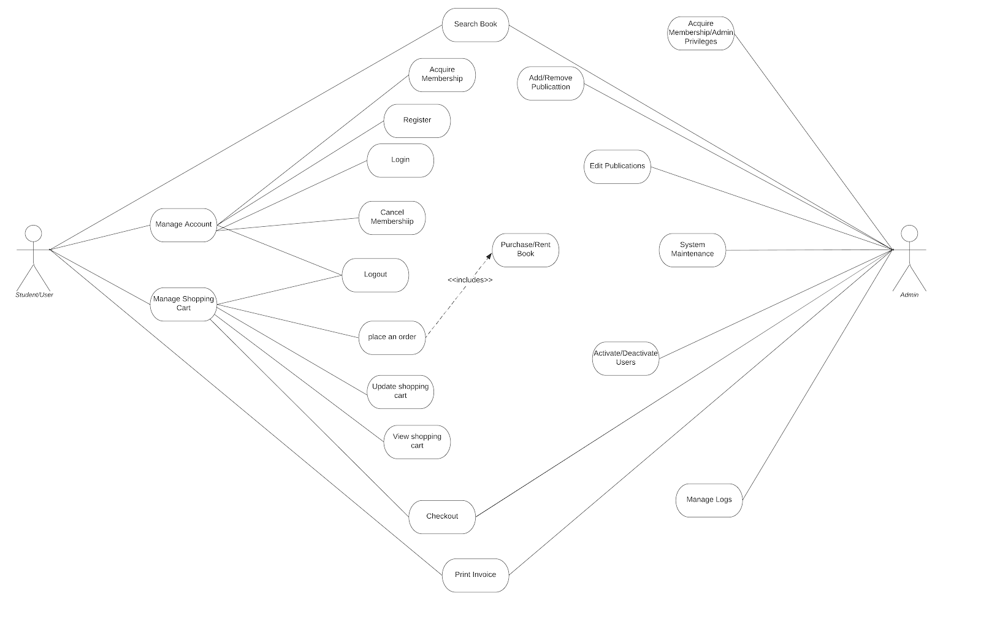
Use Case Diagram:

Slide 9
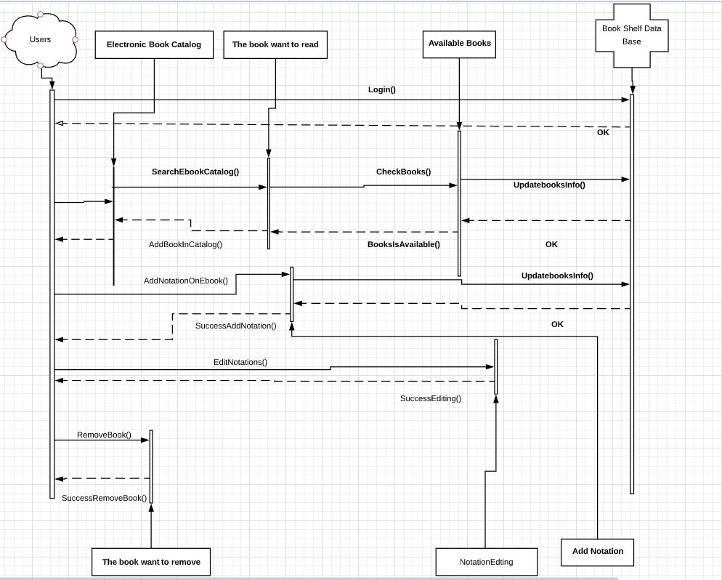
Sequence Diagram

Slide 10
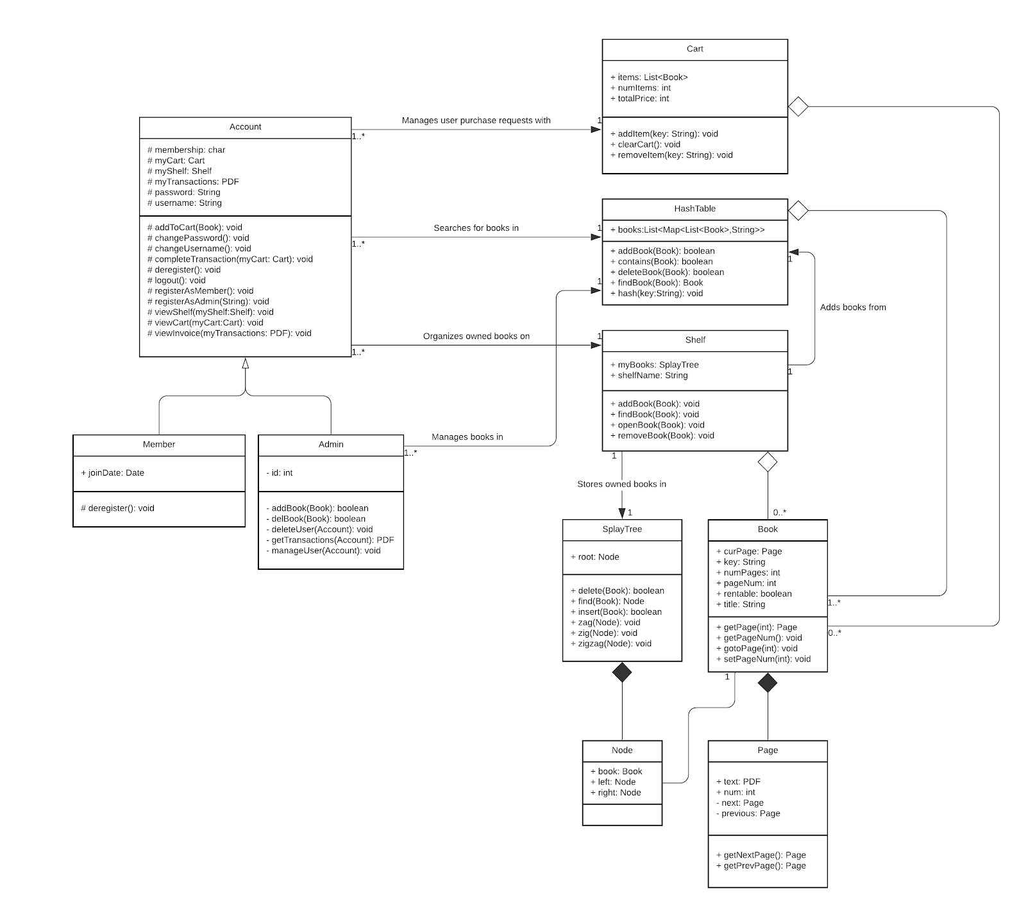
Class Diagram

Slide 11
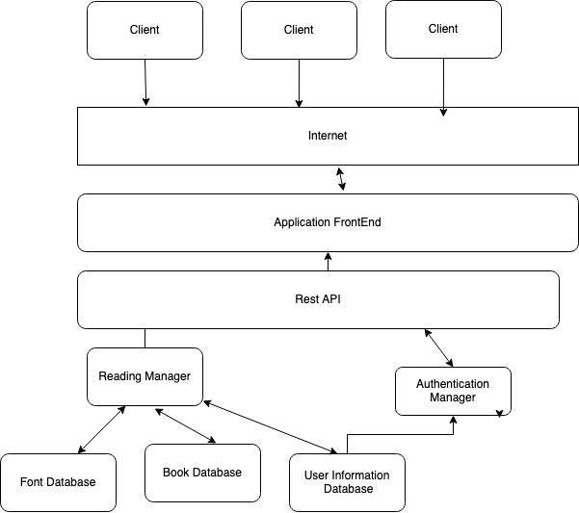
Architectural design: Client-Server

